Slide 1
Academic Library Trends in Hong Kong: Global and Local Issues
Peter E Sidorko
The University of Hong Kong

Slide 2
Overview
Background (HE in HK; JULAC)
Trends (JULAC Statistics)
Issues (JULAC Director’s views)
Conclusions (Some, maybe)

Slide 3
Some global issues
Technology
Changing collections and collecting patterns
Financial constraints
Accountability
Changing nature of scholarship

Slide 4
Hong Kong Higher Education
8 government funded institutes of higher learning (UGC)
3 ranked in the top 50 in the world – HKU (23); HKUST (33); CUHK (40) - (QS Rankings, 2012)
69,000 UGC funded students (2011/12) – 14% non-local
Four year curriculum commenced September 2012 – double cohort 3 year and 4 year programs in parallel
Double 1st year intake for each institution
Estimated total students now 86,000
Desire for “deep collaboration” among the eight
Desire to be THE Asian education hub.

Slide 5
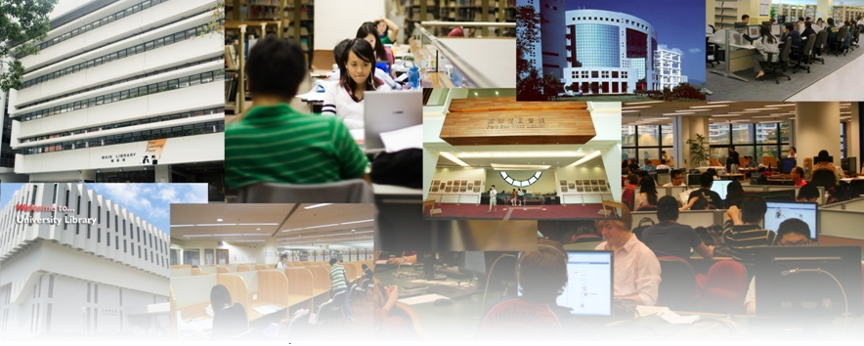
The Joint University Librarians Advisory Committee (JULAC)

Slide 6
About JULAC
Founded in 1967
Governed by JULAC Director’s Meeting
Operates around 10 specialist committees
Access services
Bibliographic Services
Committee on Media
Conservation and Preservation
Consortiall
Copyright Committee
Learning strategies
Staff Development
Statistics
Systems

Slide 7
JULAC limitations
Small in terms of member libraries
Diversity in institutional profiles and priorities
Recent departures 5/8 (soon 6/8)

Slide 8
JULAC opportunities
Small in terms of member libraries
Diversity in institutional profiles and priorities
Recent departures 5/8 (soon 6/8)
Commitment and willingness
Unitary governance (UGC through HUCOM)
Skills, specialisations, diverse educational backgrounds
Geography
JULAC Project Manager

Slide 9
Global vs local. Differences?
Maybe, let’s see

Slide 10
Trends: Collections and Access

Slide 14
JULAC
ARL
This is interesting. Why?
CAUL

Slide 15
HKALL

Slide 16
HKALL

Slide 17
Trends: Staff and Services

Slide 18
+15%

Slide 19
Ithaka Library Survey 2010
Priority for teaching and research support but less for acquisition
Growth in information literacy and support for classroom instruction
http://www.ithaka.org/ithaka-s-r/research/ithaka-s-r-library-survey-2010/insights-from-us-academic-library-directors.pdf

Slide 20
ARL
JULAC
CAUL

Slide 21
ARL
CAUL
JULAC

Slide 22
ARL
CAUL
JULAC

Slide 23
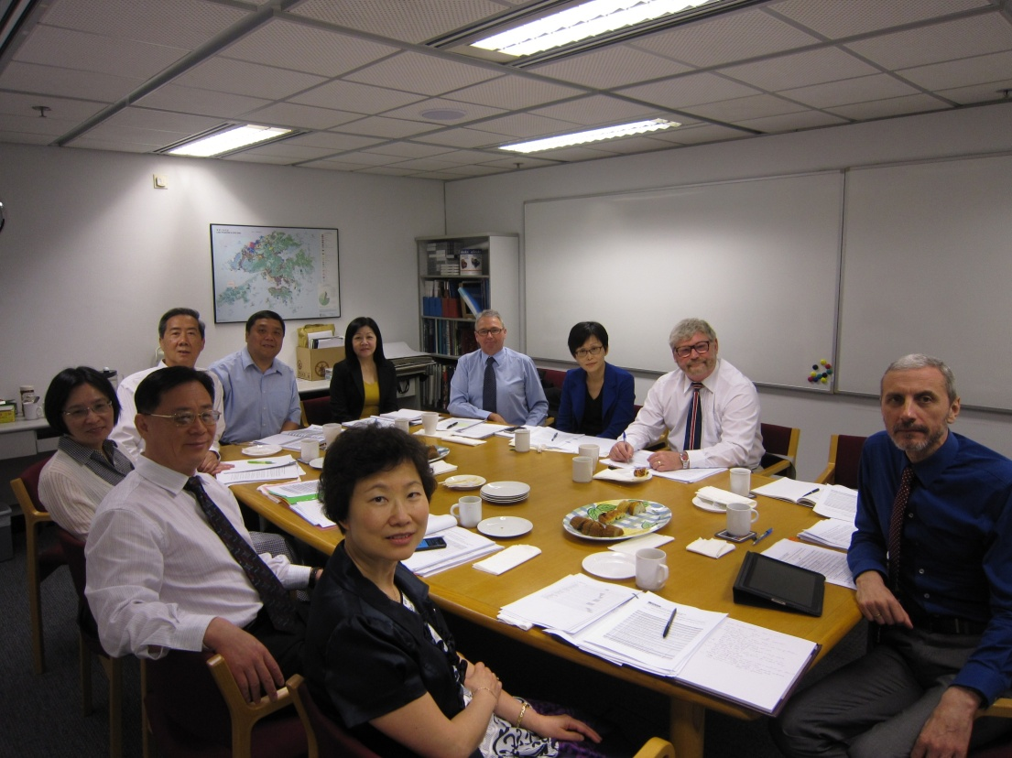
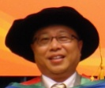
Issues: Directors’ Views

Slide 24
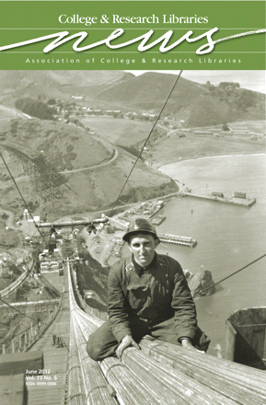
ACRL 2012 top ten trends in academic libraries
Communicating value
Data curation
Digital preservation
Higher education
Information technology
Mobile environments
Patron driven e-book acquisition
Scholarly communication
Staffing
User behaviors and expectations
http://crln.acrl.org/content/73/6/311.full

Slide 25
JULAC Director Survey (08/2012)
As a Library Director, what are the three to five major issues facing you and your library TODAY?
What do you see as the major issues for your Library in the COMING 5 YEARS?

Slide 26
ACRL 2012 top ten trends | JULAC 2012 Issues | JULAC 2017 Issues
Communicating value | 14% | 14%
Data curation | 0% | 28%
Digital preservation | 0% | 28%
Higher education | 58% | 0%
Information technology | 43% | 43%
Mobile environments | 14% | 0%
Patron driven e-book acquisition | 0% | 0%
Scholarly communication | 14% | 14%
Staffing | 71% | 86%
User behaviors and expectations | 0% | 28%

Slide 27
Response Percent
Technology
for access
Technology
uncertainty

Slide 28
ACRL 2012 top ten trends | JULAC 2012 Issues | JULAC 2017 Issues
Communicating value | 14% | 14%
Data curation | 0% | 28%
Digital preservation | 0% | 28%
Higher education | 58% | 0%
Information technology | 43% | 43%
Mobile environments | 14% | 0%
Patron driven e-book acquisition | 0% | 0%
Scholarly communication | 14% | 14%
Staffing | 71% | 86%
User behaviors and expectations | 0% | 28%

Slide 29
Notes:
2012
Staffing level, and departure of experienced staff
staff reorganisation
How to do more with existing personnel
Attracting and advancing career opportunities to bright, outgoing staff - 'the right stuff'
staff training
Attracting and advancing career opportunities to bright, outgoing staff - 'the right stuff'
organizational/structural changes in staffing numbers
Developing staff to stay abreast of latest information and technological developments
Redeploying staff from processing works into higher end tasks
Reskilling librarians

Slide 30
ACRL 2012 top ten trends | JULAC 2012 Issues | JULAC 2017 Issues
Communicating value | 14% | 14%
Data curation | 0% | 28%
Digital preservation | 0% | 28%
Higher education | 58% | 0%
Information technology | 43% | 43%
Mobile environments | 14% | 0%
Patron driven e-book acquisition | 0% | 0%
Scholarly communication | 14% | 14%
Staffing | 71% | 86%
User behaviors and expectations | 0% | 28%

Slide 31
Response Percent

Slide 32
Other Views

Slide 33
Response Percent

Slide 34
Response Percent

Slide 35
Response Percent

Slide 36
Ithaka Library Survey 2010
Priority for teaching and research support but less for acquisition
http://www.ithaka.org/ithaka-s-r/research/ithaka-s-r-library-survey-2010/insights-from-us-academic-library-directors.pdf

Slide 37
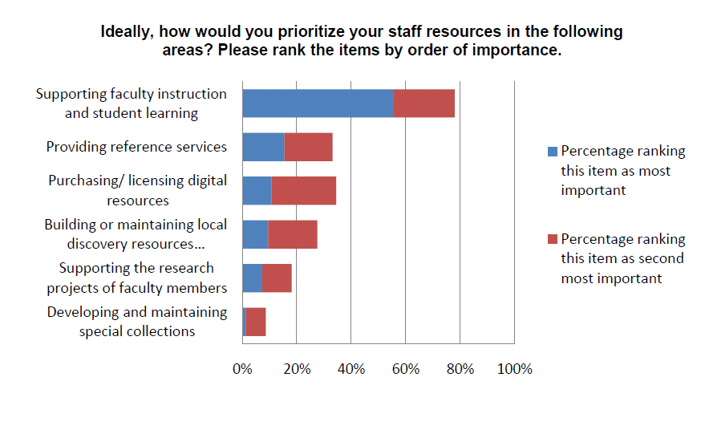
Library Director Priorities (North America)

Slide 38
Library Director Priorities (Hong Kong)

Slide 39
Ithaka Library Survey 2010
5 years to e-journals only transition
In 5 years 50% of books purchased are e-books
Offsite print journals but less so for books.
http://www.ithaka.org/ithaka-s-r/research/ithaka-s-r-library-survey-2010/insights-from-us-academic-library-directors.pdf

Slide 40
JULAC Director Survey (08/2012)
What percentage of your CURRENT materials expenditure is on digital resources?
What percentage of your materials expenditure do you think you will spend on digital resources IN 5 YEARS TIME?
IN 5 YEARS TIME, what percentage of your journals will be e-journals only?
IN 5 YEARS TIME, what percentage of your book acquisitions will be e-books only?

Slide 41
CURRENT materials expenditure on digital resources

Slide 42
Materials expenditure on digital resources IN 5 YEARS TIME
Response Percent

Slide 43
Percentage of e-journals IN 5 YEARS TIME
Response Percent

Slide 44
Percentage of e-books IN 5 YEARS TIME
Response Percent

Slide 45
So, why differences?
Different student and faculty bodies – culture and mix
Different academic structures and priorities
HK sometimes opts for a wait and see approach
Different social emphases

Slide 46
Conclusions/solutions (of sorts)

Slide 47
1 Staffing
JULAC Staff Development Committee
University of Hong Kong Libraries Annual Leadership Institute
NextGen Library Leadership Programme

Slide 48
2 Space
JURA (collaborative offsite storage) construction
The Joint Universities Research Archive
大學聯合典藏學術書庫

Slide 49
3 Funding
4 year curriculum hangover
UGC Funding
Fundraising

Slide 50
4 User behaviours and expectations
Ethnographic study of Hong Kong university students
What are the information-seeking behaviors of UGC undergraduates and graduate students?
What information seeking behaviors, if any, distinguishes Hong Kong students from others in the world?

Slide 51
Conclusions
Global trends are useful to observe, but,
Local considerations are also essential, be they regional or institutional
Culture, both ethnic and organizational, will affect what services we deliver and how we do that

Slide 52
Thank you!

